Slide 1

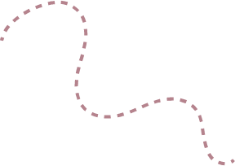



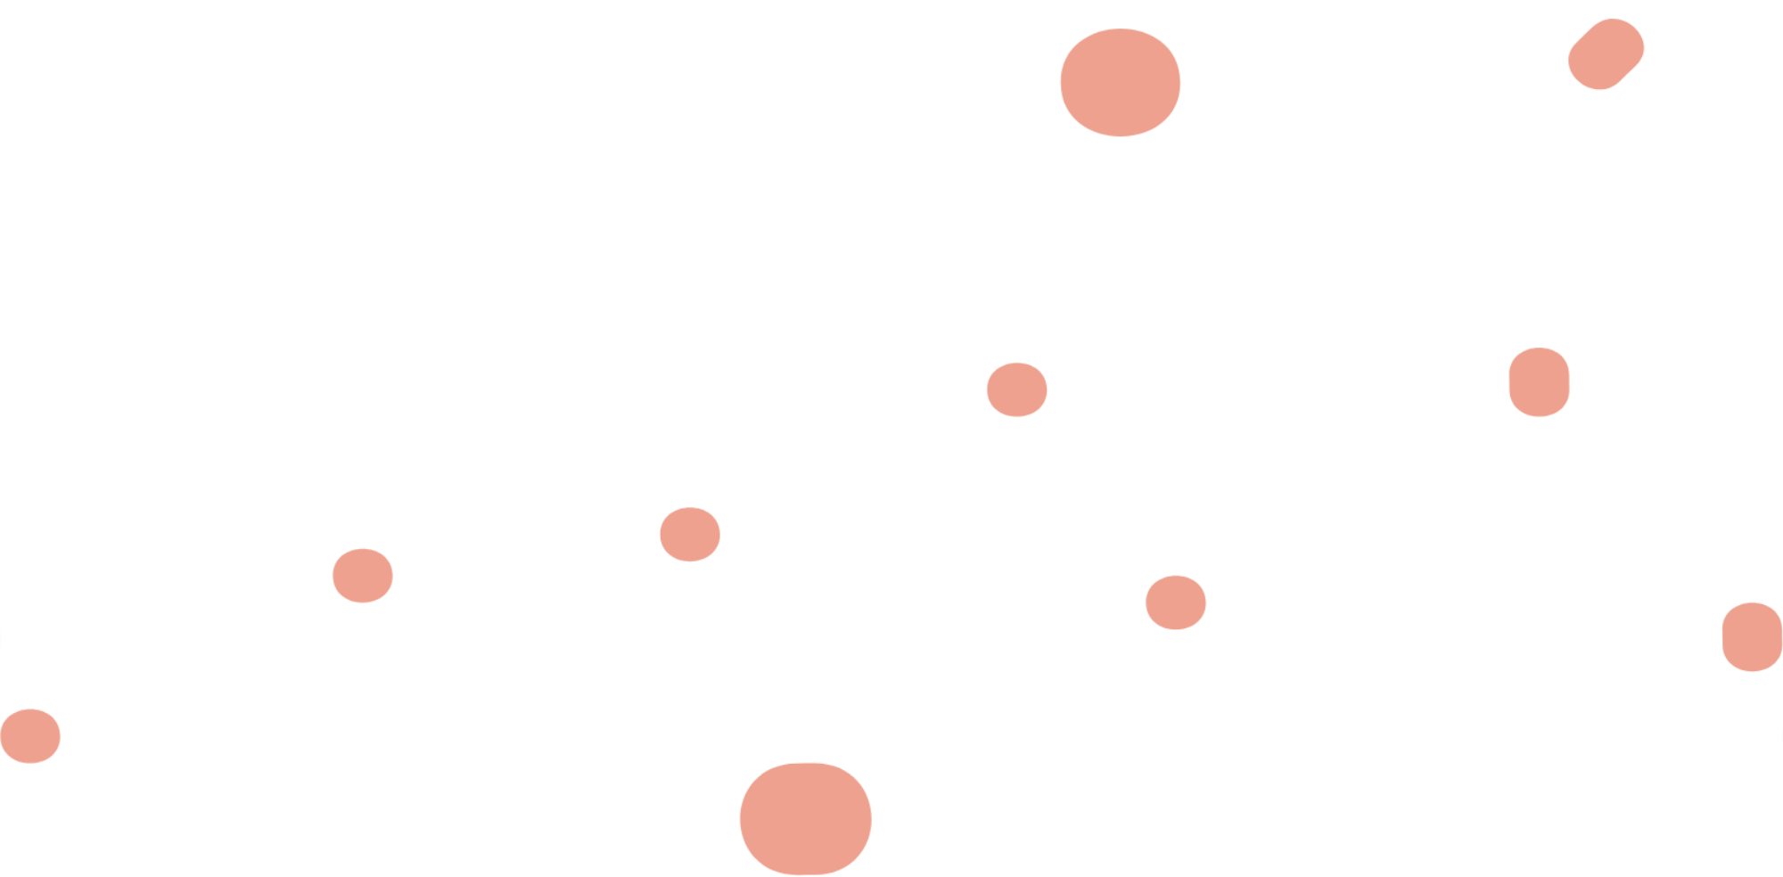



ECO WARRIORS
protection of endangered species
Presented by Group no 16

Slide 2
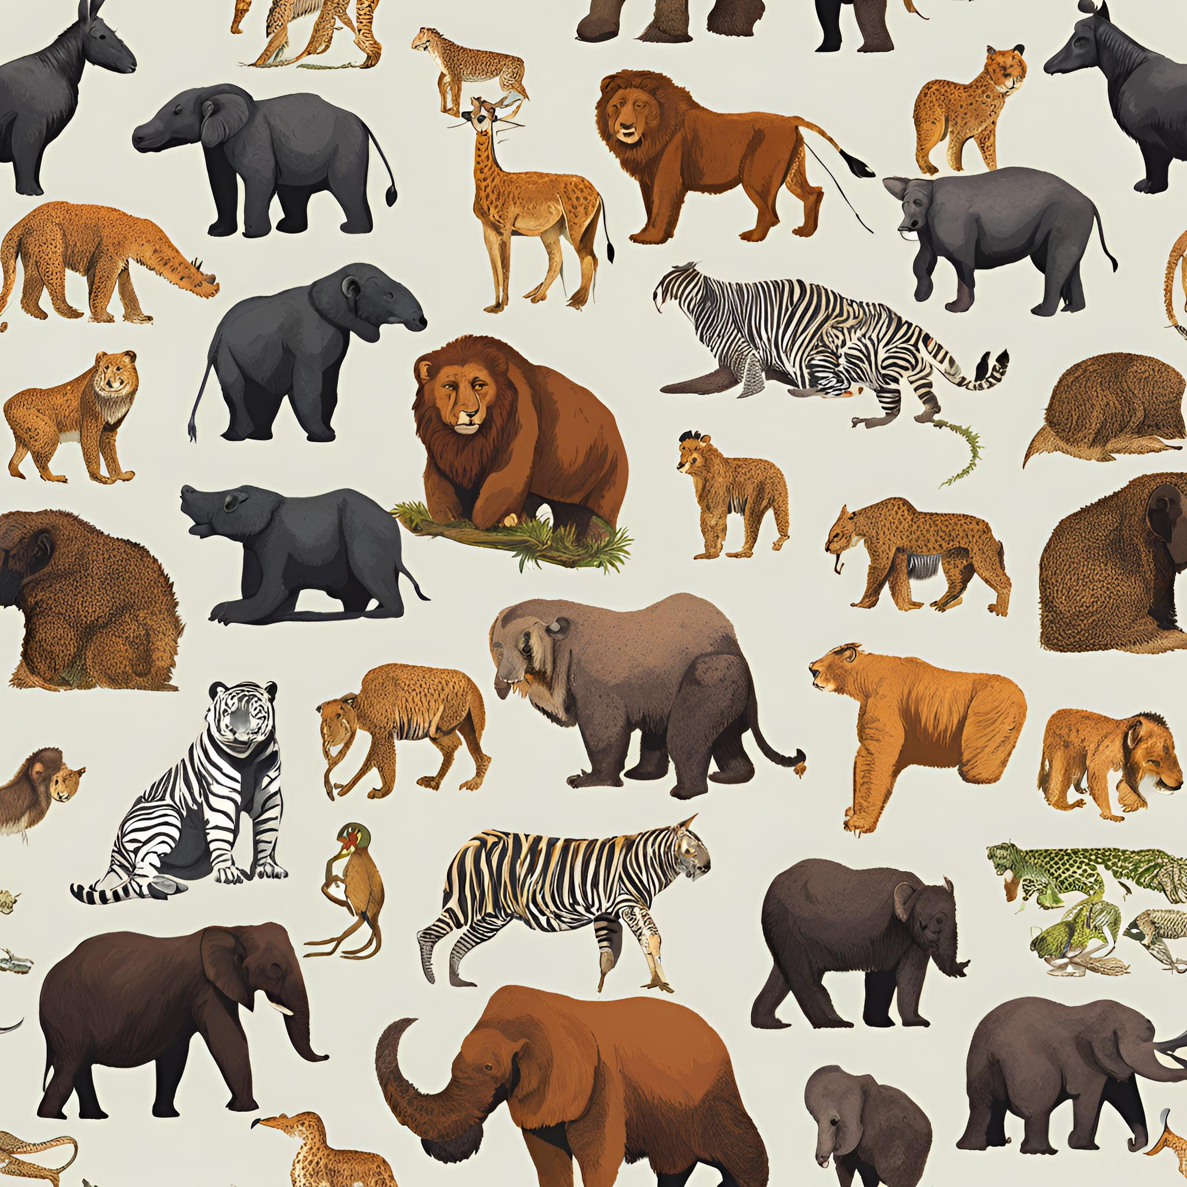
Group leader : Ayush Deore
Group members : Vedant Admane
Sarthak Patil
Smruti Gorde
Vedanti Vahadne
Sanskruti Madhawai

Slide 3


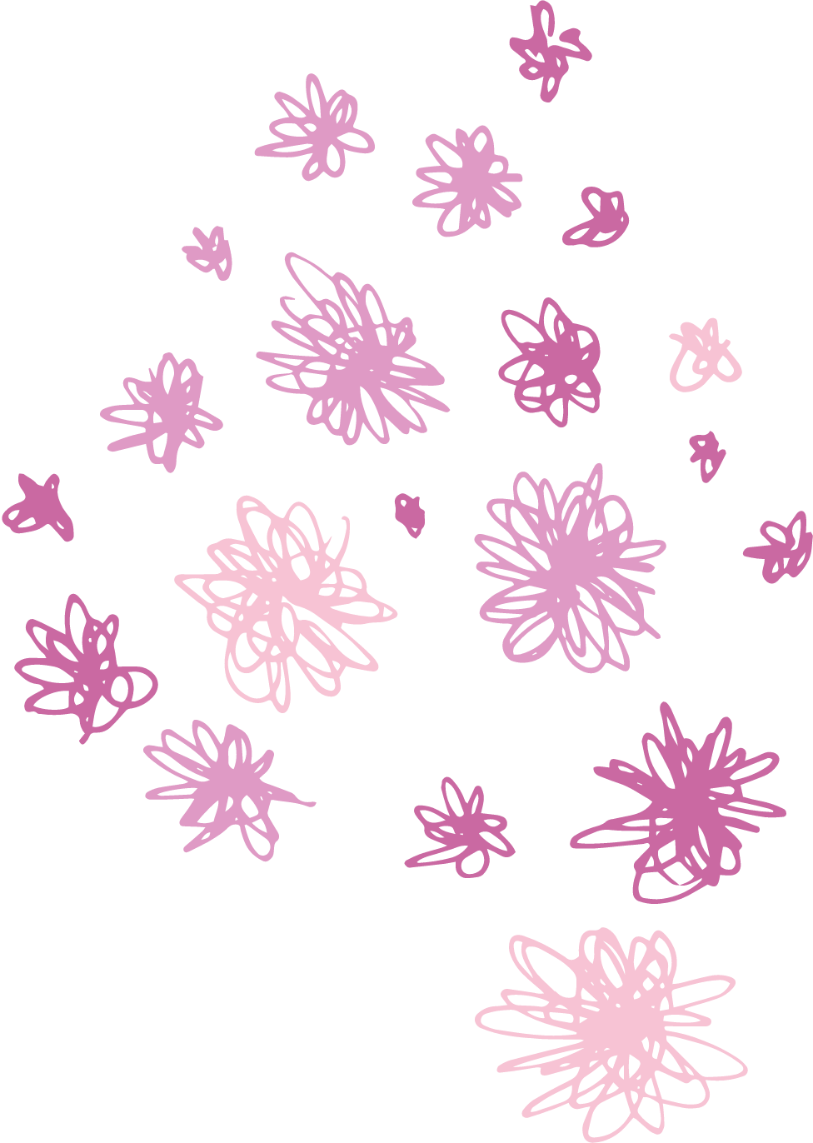

ABOUT THE PROJECT
Aims to conserve, protect and restore their populations of animals ,plant ,and other organisms at risk of extinction
The goal is to maintain biodiversity, ensuring healthy ecosystem and preserving natural balance of environment for the safety of planet and upcoming generation

Slide 4
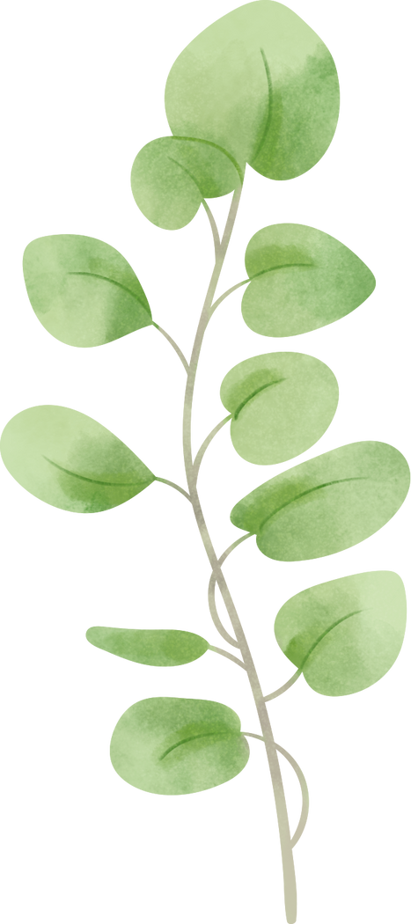







THEORY OF PRIORITIZATION
•This activity aims to help you prioritize different aspects from problems. You will assign points of 10g , 100g, and 1000g to each key feature, where higher the points the greater importance of priority.
Theory of priotarization gives a clear understanding on a
particular topic. In this first we identify all the problems related to
our topic using 5W1H matrix and give them points according to
the depth of the problem.
• We got 14 problems and prioritize them accordingly

Slide 5
PRIORITY WEIGHTAGE
SR NO. | problems | points
1 | GLOBAL WARMING
2 | LACK OF AWARNESS | 6000
3 | HUNTING
4 | HABITAT LOSS
5 | DISEASES
6 | OVEREXPLIOTATION
7 | DEFORESTATION

Slide 6
PRIORITY WEIGHTAGE
SR NO. | problems | points
8 | SPECIES MIGRATION
9 | INVASION
10 | ILLEAGEL TRADE
11 | TRANSMISSION
12 | INDUSTRIALIZATION
13 | TRANSMISSION
14 | DEGRADATION OF LAND

Slide 7
PROBLEM STATEMENT
The ongoing loss of biodiversity is one of the most serious environmental challenges. A significant factor contributing to this crisis is the lack of public awareness about the importance of protecting endangered species.

Slide 8


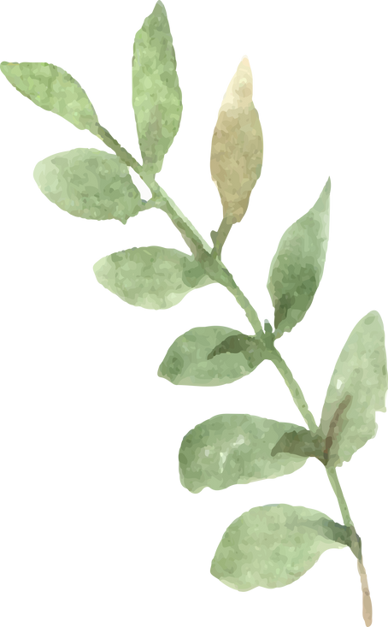




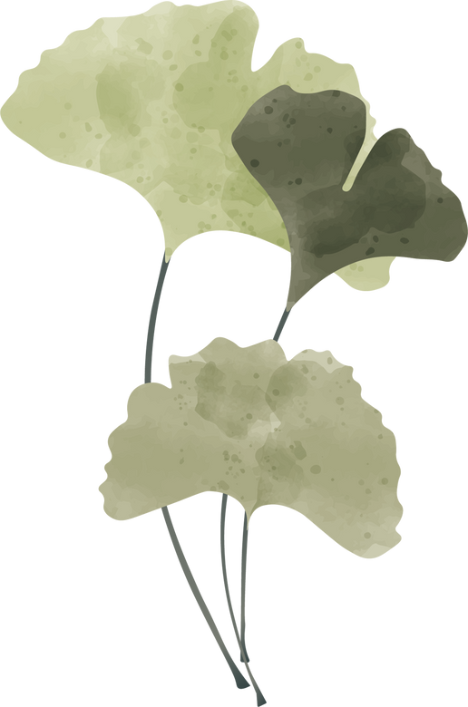
SCAMPER
SCAMPER is a device and a creative thinking technique developed by Bob Eberle in the early 1970s. It's primarily used for idea generation, problem-solving, and innovation.
SCAMPER is an acronym that stands for:
S - Substitute
C - Combine
A - Adapt
M - Modify
P - Put to Another Use
E - Eliminate
R - Rearrange

Slide 9
Tools used
In the SCAMPER technique, Modify refers to changing certain characteristics of an existing product, system, or process to improve it or make it more suitable for a particular purpose.
Reforesting: Modify habitats (National parks etc.) through reforestation or planting native species to restore ecosystems, providing necessary resources like food, shelter, and breeding areas for endangered species.
"Adapt" in the SCAMPER tool helps you to adjust existing ideas, products, or solutions to better suit a new purpose or context.
Adapt" is used to transform existing educational content from various websitee about endangered species into interactive, mobile-friendly formats, such as simplified articles and infographics making it engaging and easy for the public to understand and act on.

Slide 10
Tools we skipped
1. Substitute
Drawback: The substitute might not work as effectively.
Example: Replacing natural wetlands with artificial ponds to protect an endangered frog species might not provide the same nutrients or breeding grounds, leading to poor survival rates.
2. Combine
Drawback: Combining too many elements can create complexity.
Example: Combining wildlife corridors with human recreational spaces might lead to more human-animal conflicts rather than improving habitat connectivity for endangered species.
3. Put to Another Use
Drawback: The resource may not function effectively for its new use.
Example: Repurposing abandoned farmland for wildlife habitat may not provide sufficient cover, water, or food for endangered species like tigers, making it unsuitable as a sanctuary.
4. Eliminate
Drawback: Eliminating components can disrupt the system.
Example: Eliminating predators to protect an endangered prey species could cause overpopulation of the prey, leading to ecosystem imbalance and food shortages for other species.
5. Rearrange/Reverse
Drawback: Rearranging processes can cause confusion or harm.
Example: Reversing the order of reintroducing animals into the wild (releasing them before restoring habitat) could lead to their quick disappearance due to the lack of a suitable environment.

Slide 11
Journey map
Journey Map of Local Communities
1. Worried about the ecosystem.
2. Looks for something informative in the app.
3. Reads the latest information about endangered species.
4. Understands the importance of protecting endangered species.
5. Feels sad after reading the latest count of species.
6. Finds information about various plant species.
7. Reads information about national parks and their locations using the map.
8. Reads conservation tips.
9. Uses the app as a tourist guide.
10. Makes a donation

Slide 12
Journey map
Journey Map of Eco Tourists
1. Interested in sustainable travel options.
2. Feels confused due to the lack of a proper travel guide.
3. Searches for eco-friendly destinations and activities in the app suggested by the tourist guide.
4. Reads about the importance of protecting local wildlife and habitats.
5. Learns about endangered species in the travel area.
6. Discovers information about national parks.
7. Uses the app's map to find nearby national parks and conservation areas.
8. Reads tips on conservation practices.
9. Makes a donation to support conservation efforts.
10. Shares experiences and reviews to promote eco-tourism.

Slide 13
Journey map
Journey Map of a Research Student
1. Identifies a research topic related to endangered species or ecosystems.
2. Lacks the latest information about endangered species and their population counts.
3. Searches for detailed information and resources in the app.
4. Reads the latest data on endangered species.
5. Analyzes species population and conservation trends.
6. Finds detailed information about different plant and animal species.
7. Uses the app's map feature to locate key habitats and National parks.
8. Takes notes on conservation efforts.
9. Reads conservation methodologies and tips.
10. Shares findings and contributes to awareness campaigns.
11. Makes a donation to support conservation research.

Slide 14
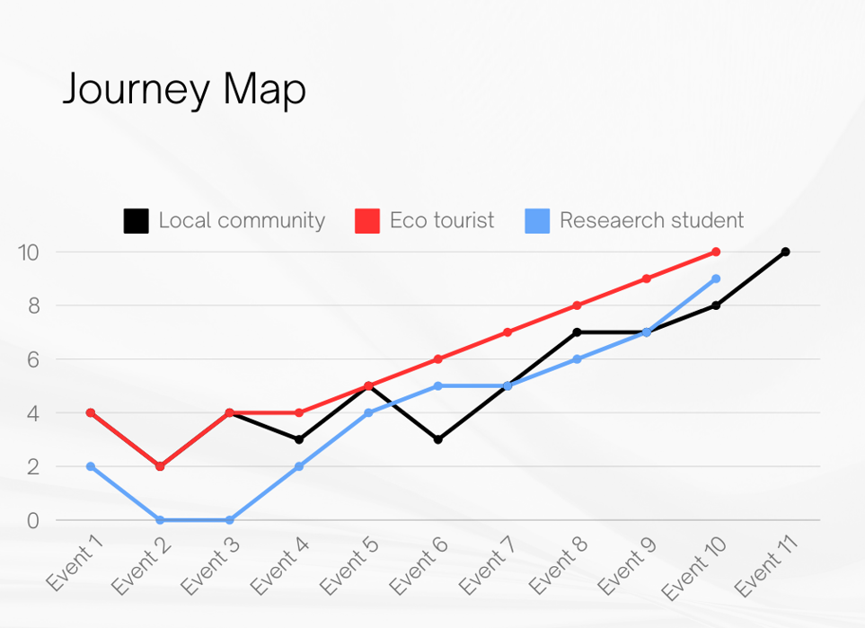
Graph

Slide 15

THANK YOU

